Slide 1

Genome-scale metabolic modelling Workshop
PhD student Iván Domenzain
2018-08-23

Slide 2
Mathematical modelling of metabolism
Metabolism is a huge network!
2018-08-23

Slide 3
Mathematical modelling of metabolism
A highly interconnected one
2018-08-23

Slide 4
Mathematical modelling of metabolism
Genome-scale metabolic models as knowledge databases.
2018-08-23

Slide 5
Mathematical modelling of metabolism
2018-08-23

Slide 6
Mathematical modelling of metabolism
2018-08-23

Slide 7
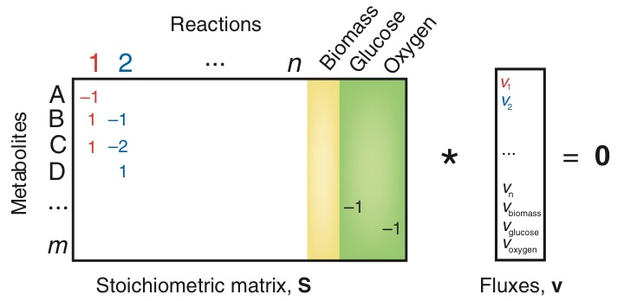
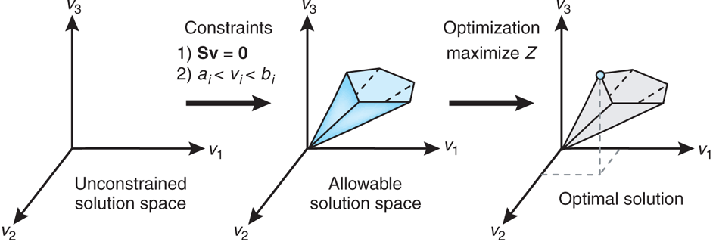
Constraint based methods
[1] Orth, J., et al., Nature Biotechnology, 2010.
2018-08-23

Slide 8
Linear programming
2018-08-23

Slide 9
Linear programming
Unique optimal solution
Alternate optima
Unbounded polytope
2018-08-23

Slide 10
Different objective functions
Schuetz, R., Kuepfer, L. & Sauer, U. (2007). Molecular systems biology 3,119.
2018-08-23

